Slide 2
The Facts
About Electronic Vapor Products
Health Impacts
Disparities in E-Cigarette Use
Fact vs Fiction
Flavoring
Identifying Electronic Vapor Products
Signs A Teen is Vaping
Cannabis
Benefits of Quitting
My Life, My Quit
Alternatives to School Suspension
FAQ
How You Can Help
Steps for Success
Order Free Resources
For More Information

Slide 3
E-cigarettes are the most popular tobacco product among middle and high school students
1 in 10 high school students and 1 in 20 middle school students use e-cigarettes
In 2023, 12.7% of high school students & 8.0% of middle school students in Clark County reported using e-cigarettes in the last 30 days
Adolescent nicotine use can increase the risk of substance misuse, addiction, mood disorders, and permanent lowering of impulse control
Smoking increases the risk of heart disease, stroke, cancer, and early death
The vape industry illegally markets to youth, targeting teens to create lifelong addictions

Slide 4
Using an electronic vapor product is sometimes called “vaping”
Electronic vapor products are sometimes called “e-cigarettes,” “e-cigs,” “e-hookahs,” “mods,” “vape pens,” “vapes,” “tank systems,” and “electronic nicotine delivery systems (ENDS)”
E-cigarettes can be used to deliver cannabis and other drugs

Slide 5
E-cigarettes come in many shapes and sizes
Some e-cigarettes are made to look like regular cigarettes, cigars, or pipes
Others resemble pens, USB sticks, and other everyday items

Slide 6
E-cigarettes often contain harmful substances, including:
Nicotine
Flavoring such as diacetyl, a chemical linked to a serious lung disease
Cancer-causing chemicals
Heavy metals such as nickel, tin, and lead
Nicotine can harm adolescent brain development, which continues into the early to mid-20s
Youth who use e-cigarettes or vapes are more likely to become chronic smokers, leading to nicotine addiction and damage to their developing brains
Smoking at a young age increases the risk of heart disease, stroke, cancers, and early death

Slide 7
In Nevada, Hispanic/Latinx high school students use tobacco products at the highest rate
In Nevada, white high school students use e-cigarettes at the highest rate, followed by Hispanic/Latinx and multiracial youth
Tobacco use rates are elevated among LGBT youth
Potential risk factors:
Lack of support from family and peers
Depression
Low self-esteem
Stress

Slide 8
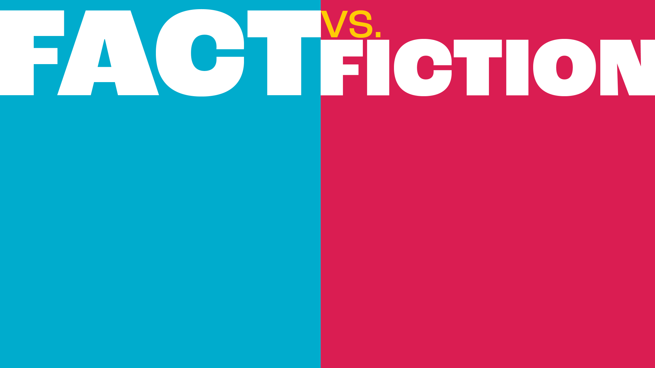
Cigarette smoking is responsible for more than 480,000 deaths per year in the United States. FACT
Tobacco smoke contains at least 250 harmful chemicals, around 70 of which are known to cause cancer. FACT
Teens who use e-cigarettes go on to smoke cigarettes. FACT
Most teenagers smoke. FICTION
The vapor produced by e-cigarettes consists primarily of water. FICTION
The flavorings used in e-cigarettes are safe to inhale into the lungs. FICTION

Slide 9
Masks the harshness of tobacco, making smoking more tolerable to new users
Entices youth to try tobacco products
Bright colorful packaging, sweetened flavors, and fun names target youth
Youth who use flavored tobacco products are more likely to become chronic smokers, experience nicotine addiction, and cause damage to their developing brains

Slide 10
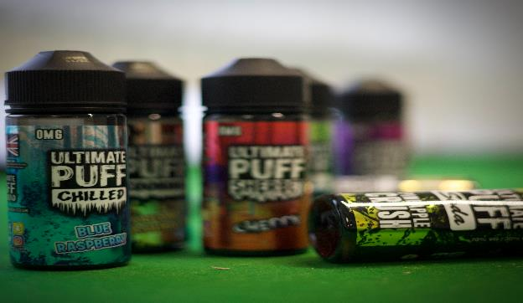
The most popular flavor types among teens:
Fruit
Candy, desserts, or other sweets
Mint

Slide 11
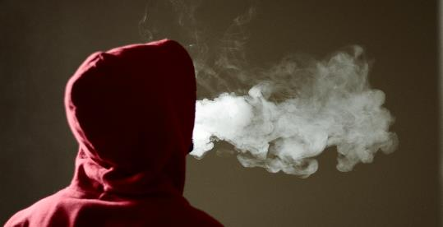
Dry mouth
Drinking more
Craving more salt or spice
Shortness of breath
Smoker’s cough
Lung infections
Chest pain
Throat clearing
Difficulty tasting
Mouth sores
Increased thirst
Nosebleeds
Dry eyes
Skin damage
Changes in eating habits
Nausea or vomiting
Weight loss
Sleep disturbance

Slide 12
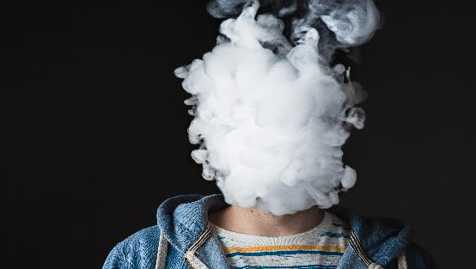
Unknown deliveries/increased spending
Behavior changes, mood swings, agitation, or withdraw
An unexplained sweet scent
White vapor or smoke
Increased sensitivity to caffeine or jitteriness
Frequent bathroom pass requests
Unusual packages or items such as batteries, chargers, USB drives, cartridges, small highlighters, or pens
Residue on surfaces, especially glass
Secretive attitude

Slide 13
Vaping cannabis is not safer than smoking it
Vaping cannabis can cause bloodshot eyes, dry mouth and thirst, increased appetite, and shifts in behavior or mood
Products like vaporized concentrated waxes and oils may contain more THC
Vaping cannabis can expose users to EVALI (E-Cigarette or Vaping Product-Use Associated Lung Injury), harmful cancer-causing chemicals, and marijuana poisoning

Slide 14
Lowers levels of anxiety, depression, and stress, as well as improved positive mood and quality of life, compared with continuing to smoke
Improves health and enhances quality of life
Reduces risk of adverse health effects, such as lung illness and damage to the brain

Slide 15
My Life, My Quit is a free and confidential service for youth ages 13 - 18 who want help quitting all forms of tobacco, including electronic vapor products
For FREE help to quit smoking or vaping:
TEXT: “Start My Quit” to 36072
CALL: 855-891-9989
VISIT: mylifemyquit.org

Slide 16
Intervention for Nicotine Dependence: Education, Prevention, Tobacco and Health (INDEPTH) is a free program recommended to address vaping in schools
Instead of citations or suspension, INDEPTH teaches students about nicotine dependence, healthy alternatives, and overcoming addiction
Delivered in (4) 50-minute sessions
60% of student participants reported that they were willing to quit after completing INDEPTH

Slide 17
Do all electronic vapor products contain nicotine?
Nearly all do – and those that don't have nicotine still have harmful chemicals in them
Many marketed as nicotine-free still contain nicotine
Is vaping healthier than smoking cigarettes?
The long-term health effects of electronic vapor products are still unknown
The FDA has not found any electronic vapor products to be safe and effective to help people quit smoking

Slide 18
Why are electronic vapor products so popular among youth?
Illegal marketing to youth by the tobacco industry
Candy and fruit flavors appeal to youth
Can teens under age 18 legally vape and buy electronic vapor products?
No - The legal sales age for all tobacco products is 21, nationwide and in Nevada
Youth may get products from older peers and restrictions at stores are not always enforced

Slide 19
Share Information
Ask what the teen needs from you and how you can help
Raise awareness of the risks of vaping and nicotine addiction
Vaping is tobacco and it has the same addictive properties whether they are smoking cigarettes or electronic vapor products
Let them know the longer someone uses nicotine, the more addicted they are likely to become, and the harder it will be to stop

Slide 20
Set A Good Example
Pro-smoking environments influence youth uptake of smoking, patterns, and quitting intentions
For free help to quit smoking or vaping, contact the Nevada Tobacco Quitline
Call 1-800-QUIT-NOW (1-800-784-8669)
Text QUITNOW to 333888
Visit www.gethealthyclarkcounty.org

Slide 21
Let teens know you are concerned
Tell them you want to support their plan to stop and ask if they will sign up for My Life, My Quit
If they are not willing to enroll right then, provide them with information about how to enroll and let them know they have support to help them quit

Slide 22
Promote and use available vaping prevention resources in classrooms, school facilities and social media
Promote My Life, My Quit
Following the INDEPTH alternative to suspension model for non-punitive intervention

Slide 23
Share these steps to help students successfully quit smoking or vaping:
1) Set a date to quit
2) Stay motivated by identifying reasons to quit
3) Changing routines to remove temptations
4) Rewards for not smoking at every milestone
5) Know that every smoker can quit, and to keep trying

Slide 24
Download, print, or order FREE materials to display in your classroom and school Materials are updated on a regular basis Check our online store to view the current supply
Contact TobaccoProgram@snhd.org for printed materials to be mailed to you
Read the FREE Toolkit for Educators and Administrators

Slide 25
To obtain additional assistance please call the Southern Nevada Health District Tobacco Control Program at 702-759-1270 or email TobaccoProgram@snhd.org
To learn more:
Get Healthy Clark County – Tobacco Control and Prevention efforts in Southern Nevada
My Life, My Quit - Cessation Resources offered for youth 13-18 in Nevada
Let’s Talk Vaping - Ways to talk to youth about vaping

