Slide 1
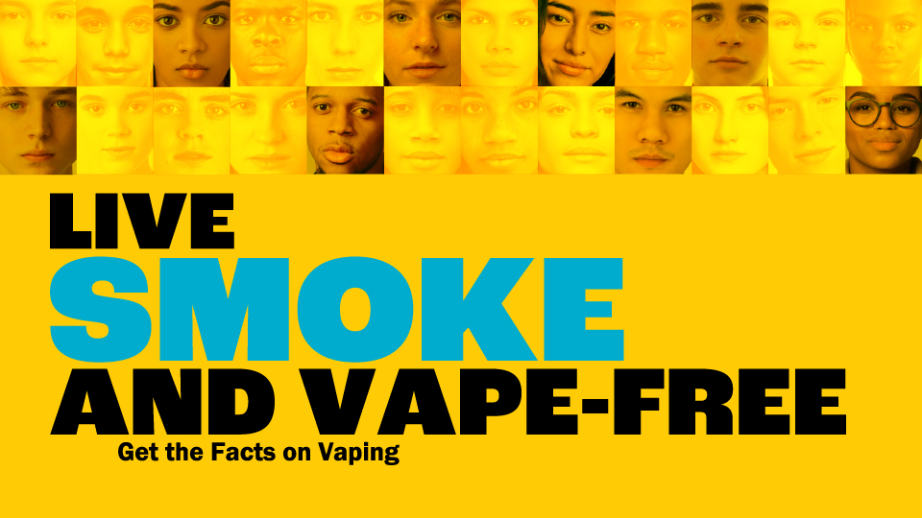

Slide 2

Fact vs Fiction
Health Impacts
Flavoring
Cannabis
Benefits of Quitting
My Life, My Quit

Slide 3


Vaping is healthy
and harmless.

Slide 4


Vaping is healthy and harmless.
FICTION
Vaping harms both your mental and physical health.
Vaping has been linked to over 3000 known cases of serious lung Injury when a person's lungs become damaged from substances contained in e-cigarettes and vaping products.

Slide 5
The vapor produced by vapes
consists primarily of water.

Slide 6

The vapor produced by vapes consists primarily of water.
FICTION
IT’S NOT JUST WATER VAPOR.
Vapes produce an aerosol by heating a liquid that usually contains nicotine, flavoring, and other harmful chemicals – like diacetyl, a chemical linked to serious lung disease and several cancer-causing chemicals.

Slide 7
Cigarette smoking is responsible for more than 480,000 deaths per year in the United States.

Slide 8
Cigarette smoking is responsible for more than 480,000 deaths per year in the United States.
FACT
This accounts for about 1 in 5 deaths annually, or 1,300 deaths every day.
On average, smokers die 10 years earlier than nonsmokers.

Slide 9
Vaping helps reduce symptoms of anxiety and depression.

Slide 10
Vaping helps reduce symptoms of anxiety and depression.
FICTION
Vaping has been found to worsen symptoms of anxiety and depression.
It can also lead to trouble paying attention, memory problems, mood swings, and lower motivation.

Slide 11
Tobacco smoke contains at least 250 harmful chemicals, around 70 of which are known to cause cancer.

Slide 12

Tobacco smoke contains at least 250 harmful chemicals, around 70 of which are known to cause cancer.
FACT
Of the more than 7,000 chemicals in tobacco smoke, at least 250 are known to be harmful, including hydrogen cyanide, carbon monoxide, and ammonia.

Slide 13
I am 18 years old, so I can buy tobacco products.

Slide 14
I am 18 years old, so I can buy tobacco products.
FICTION
The legal sales age for tobacco products, including vapes, is 21 – nationwide and in Nevada.
The legal age to ask for ID verification age is 30.

Slide 15
The flavorings used in vapes are safe to inhale into
the lungs.

Slide 16
The flavorings used in vapes are safe to inhale into the lungs.
FICTION
Flavors contain harmful chemicals NOT meant to be inhaled.
Flavors also mask the harshness of tobacco, making the toxins from smoking more tolerable to new users.

Slide 17
Some vapes marketed as containing 0% nicotine have been found to contain nicotine.

Slide 18
Some vapes marketed as containing 0% nicotine have been found to contain nicotine.
FACT
Vapes do not always disclose that they contain nicotine.
‘Nicotine-free’ labels are often false advertising.
Nearly all vapes contain nicotine.

Slide 19
Vaping is not healthier than smoking cigarettes.

Slide 20
Vaping is not healthier than smoking cigarettes.
FACT
Vapes have been found to contain many of the same toxic chemicals as regular cigarettes.
Vaping can also put users at higher risk of nicotine addiction compared to regular cigarettes.
One vape pod can contain as much nicotine as an entire pack of cigarettes.

Slide 21

Vaping is not safe
Most vapes contain harmful substances, including:
  Nicotine- the same drug found in regular cigarettes, cigars, and other tobacco products
  Flavoring such as diacetyl, a chemical linked to a serious lung disease
  Cancer-causing chemicals
  Heavy metals such as nickel, tin, and lead
Nicotine addiction increases the risk of heart disease, stroke, cancers, and early death

Slide 22
Nicotine harms brain development, which continues into the early to mid-20s
Nicotine causes memory problems, difficulty paying attention, mood swings, lower motivation, depression, and anxiety
Vaping has been linked to over 3,000 known cases of serious lung Injury and dozens of deaths due to EVALI (E-Cigarette or Vaping Product-Use Associated Lung Injury)
Vaping has been linked to Popcorn Lung – a serious condition that causes airways to become inflamed, damaged, and scarred from inhaling toxic substances or from infection

Slide 23


Flavoring masks the harshness of tobacco, making smoking more tolerable to new users
Flavors contain harmful chemicals NOT meant to be inhaled
Using flavored tobacco products like vapes increases the risk of becoming addicted to nicotine

Slide 24


Flavoring is a social justice issue
Tobacco companies have a long history of using menthol and other flavors to target minority populations – especially African American, Hispanic/Latinx, and LGBT individuals
This results in higher tobacco death rates among minority populations by increasing their risk of cancer, lung disease, heart problems, and more

Slide 25
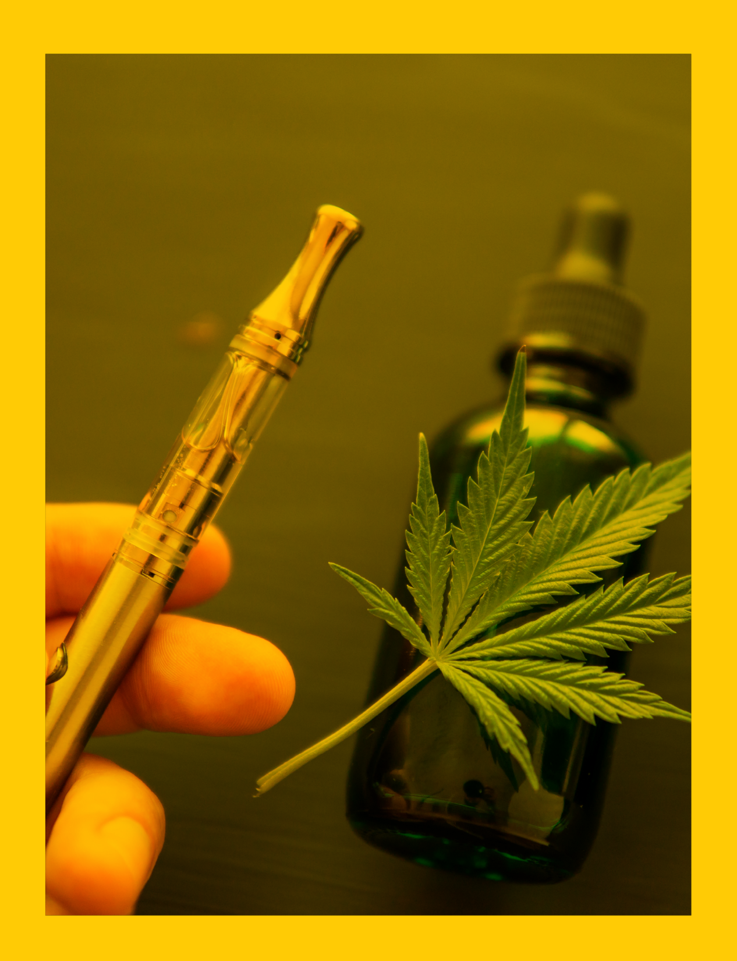

Vaping cannabis is not safer than smoking it
Vaping cannabis can cause bloodshot eyes, dry mouth and thirst, increased appetite, and shifts in behavior or mood
Products like vaporized concentrated waxes and oils may contain more THC, increasing the risk of marijuana poisoning
Vaping cannabis can expose users to cancer-causing chemicals

Slide 26


Lowers levels of anxiety, depression, and stress, as well as improved positive mood and quality of life, compared with continuing to smoke
Improves health and enhances quality of life, potentially adding as much as 10 years to life expectancy
Reduces risk of adverse health effects, such as cardiovascular diseases, chronic obstructive pulmonary disease, and cancer

Slide 27


My Life, My Quit is a free and confidential service for teens who want help quitting all forms of tobacco, including vapes
For FREE help to quit smoking or vaping:
        TEXT: “Start My Quit” to 36072
        CALL: 855-891-9989
        VISIT: mylifemyquit.org

Slide 28


